Slide 1




Slide 2
Lamentation—
Raising Our Voices

Slide 3
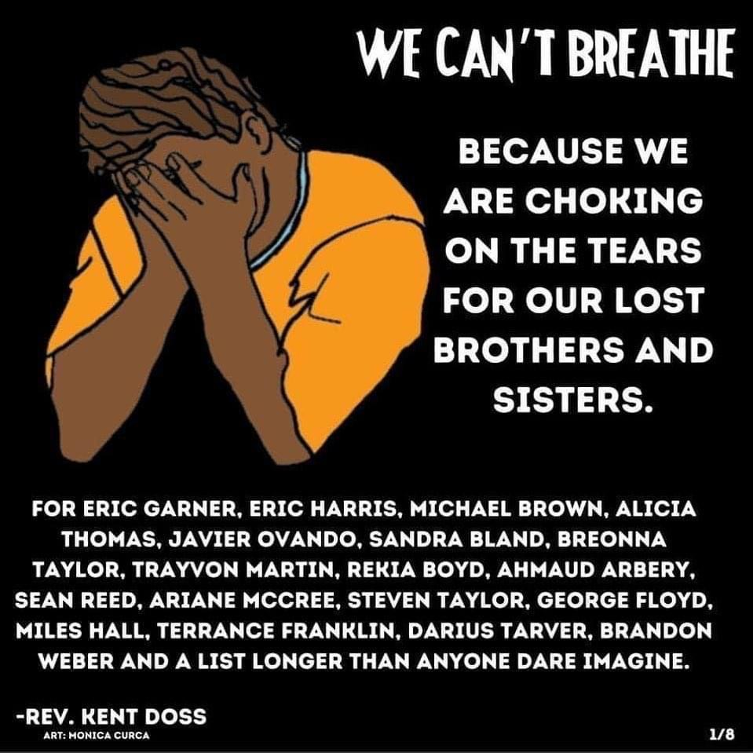
A Virtual Faith- Centered Vigil to
Denounce White Supremacy and
the Impact of Police Violence on
Black Communities

Slide 4
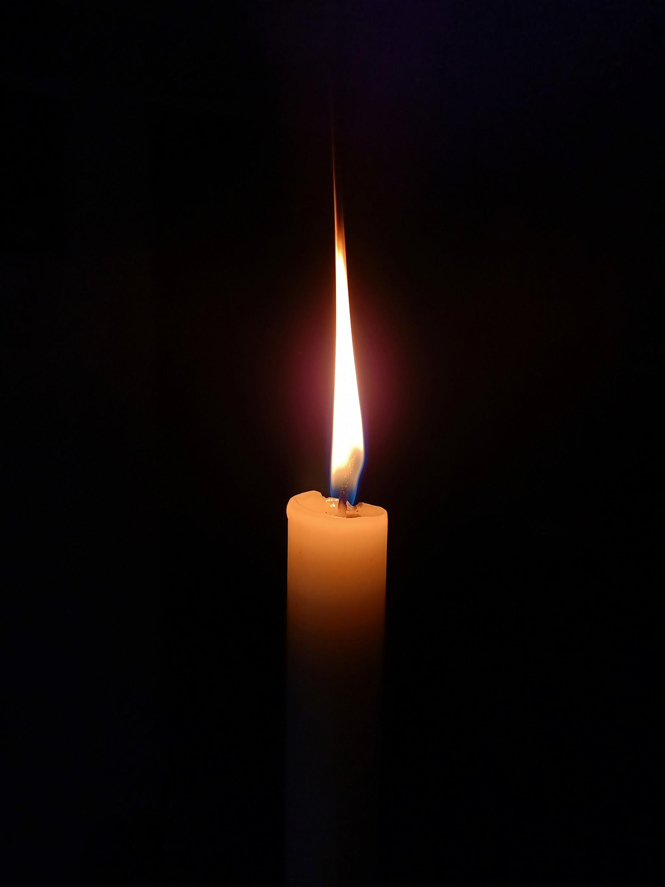
Candle Lighting
As we move into our time where we hold vigil for Black lives lost to police violence and the impact of racism on our lives and communities, please take the time now to light a candle.

Slide 5
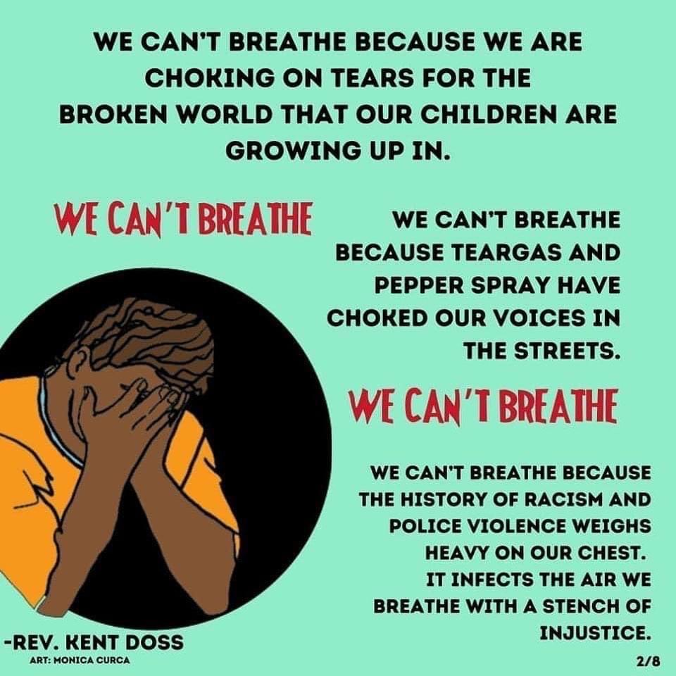
The words “I can’t breathe” made national headlines in July, 2014 with the death of Eric Garner, and again in May, 2020 with the death of George Floyd, both due to police violence.

Slide 6
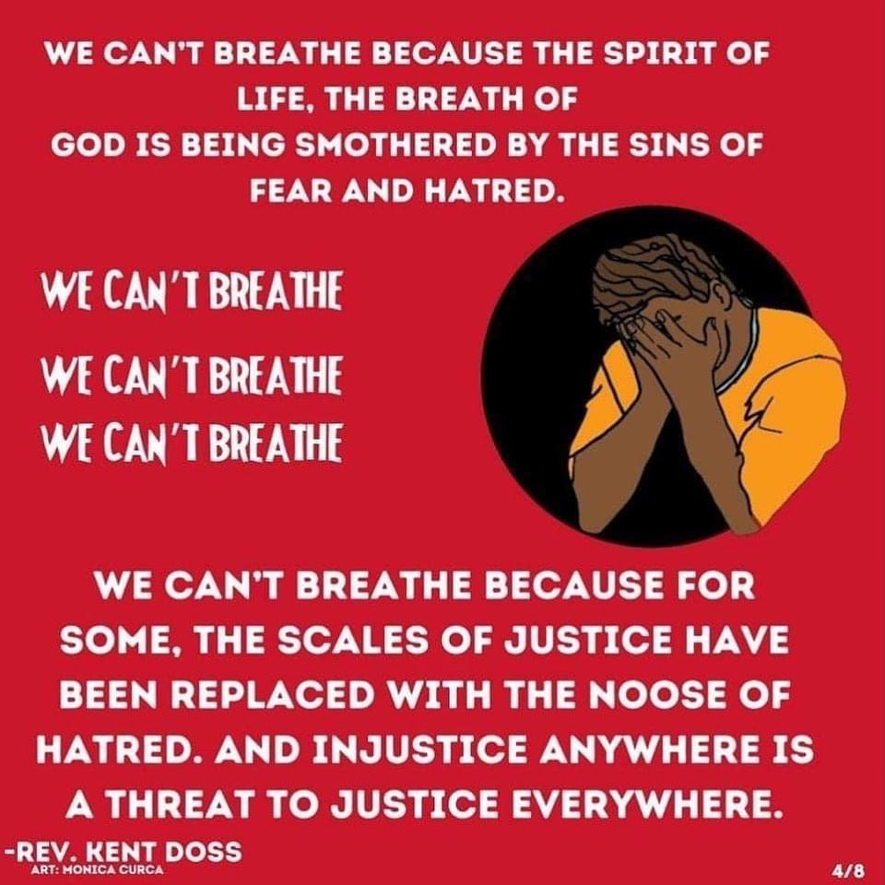
For the next 8 minutes 46 seconds, we ask you to light a candle, and watch the names of 100 Black men and women killed by police violence between July 2014 and May 2020.
This list is not exhaustive.

Slide 7
Eric Garner

Slide 8
John Crawford III

Slide 9
Michael Brown

Slide 10
Ezell Ford

Slide 11
Dante Parker

Slide 12
Michelle Cusseaux

Slide 13
Laquan McDonald

Slide 14
George Mann

Slide 15
Tanisha Anderson

Slide 16
Akai Gurley

Slide 17
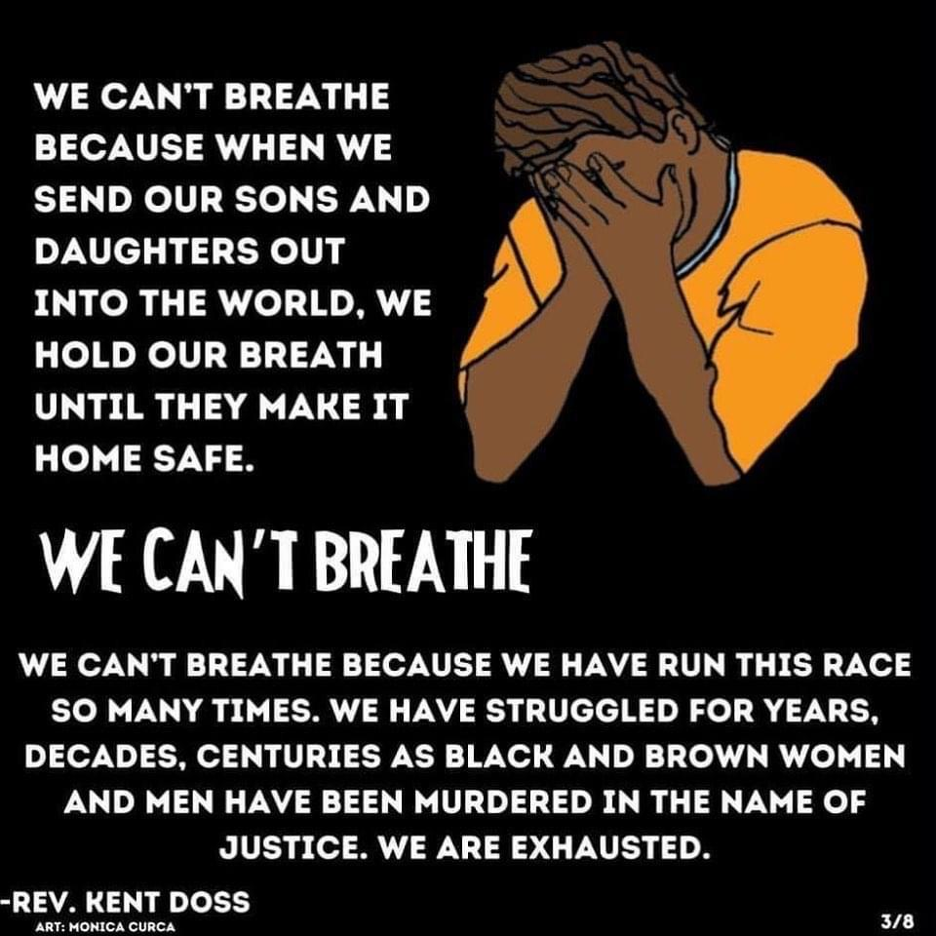

Slide 18
Tamir Rice

Slide 19
Rumain Brisbon

Slide 20
Jerame Reid

Slide 21
Matthew Ajibade

Slide 22
Frank Smart

Slide 23
Natasha McKenna

Slide 24
Tony Robinson

Slide 25
Anthony Hill

Slide 26
Mya Hall

Slide 27
Phillip White

Slide 28
Eric Harris

Slide 29
Walter Scott

Slide 30
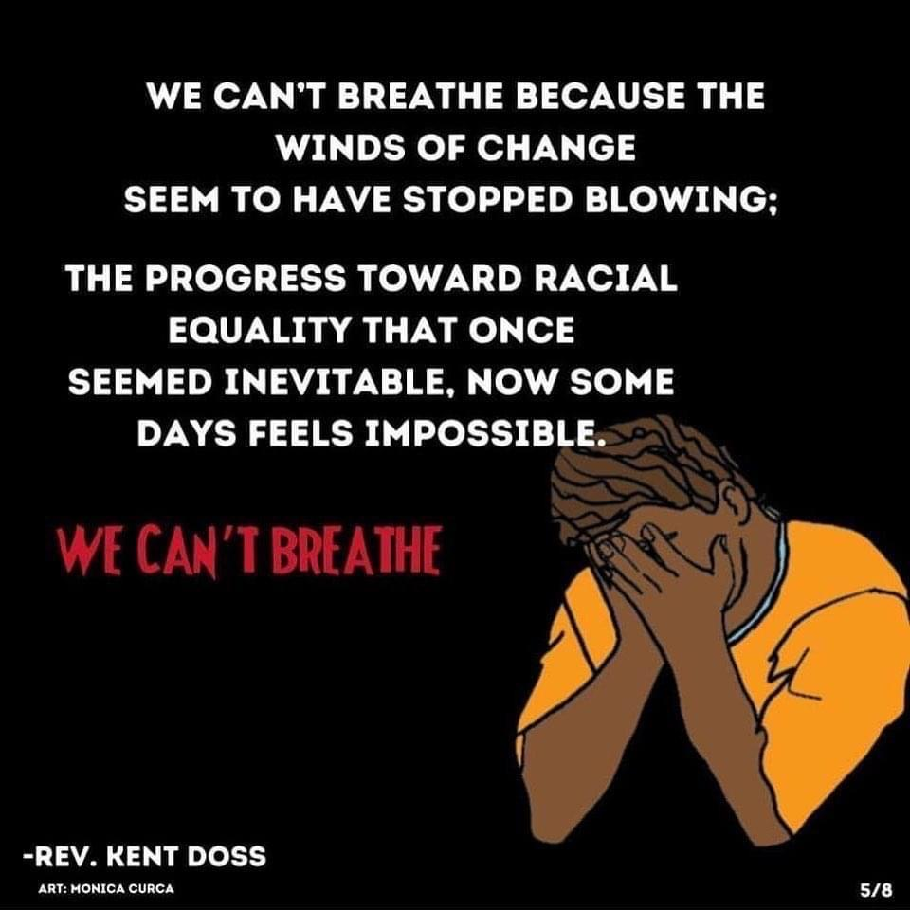

Slide 31
William Chapman II

Slide 32
Alexia Christian

Slide 33
Brendon Glenn

Slide 34
Victor Manuel Larosa

Slide 35
Jonathan Sanders

Slide 36
Freddie Blue

Slide 37
Joseph Mann

Slide 38
Salvado Ellswood

Slide 39
Sandra Bland

Slide 40
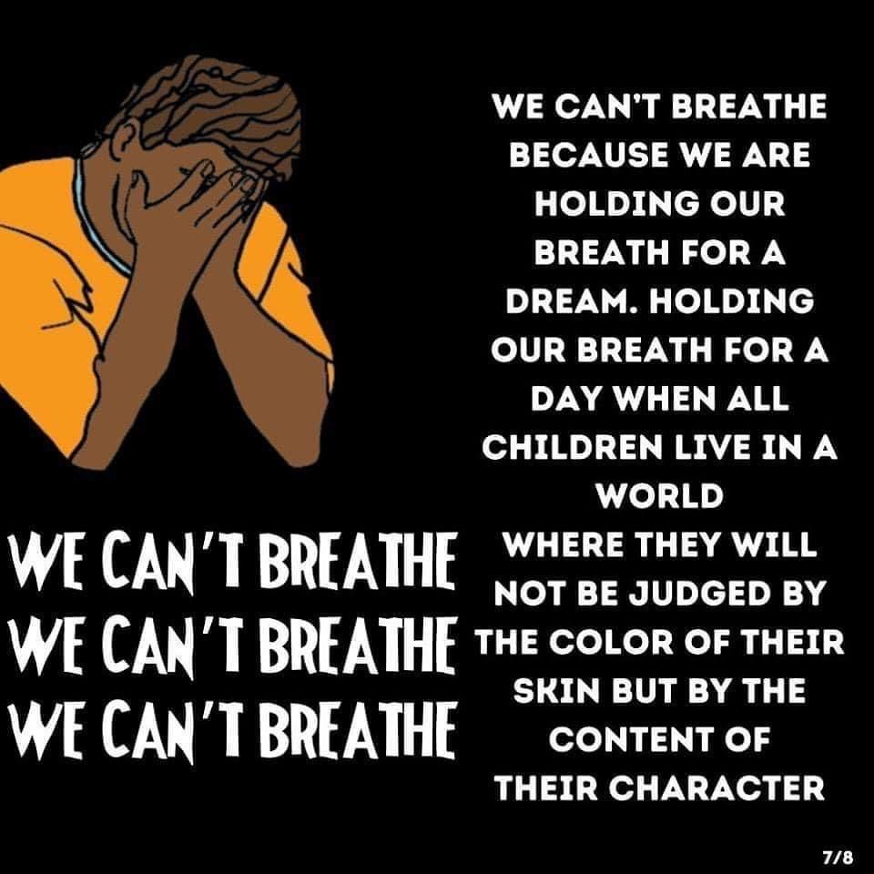

Slide 41
Albert Joseph Davis

Slide 42
Darrius Stewart

Slide 43
BIlly Ray Davis

Slide 44
Samuel Dubose

Slide 45
Michael Sabbie

Slide 46
Brian Keith Day

Slide 47
Christian Taylor

Slide 48
Troy Robinson

Slide 49
Asshams Pharoah Manley

Slide 50
Felix Kumi

Slide 51
Keith Harrison McLeod

Slide 52
Junior Prosper

Slide 53
Lamontez Jones

Slide 54
Paterson Brown

Slide 55
Dominic Hutchinson

Slide 56
Anthony Ashford

Slide 57
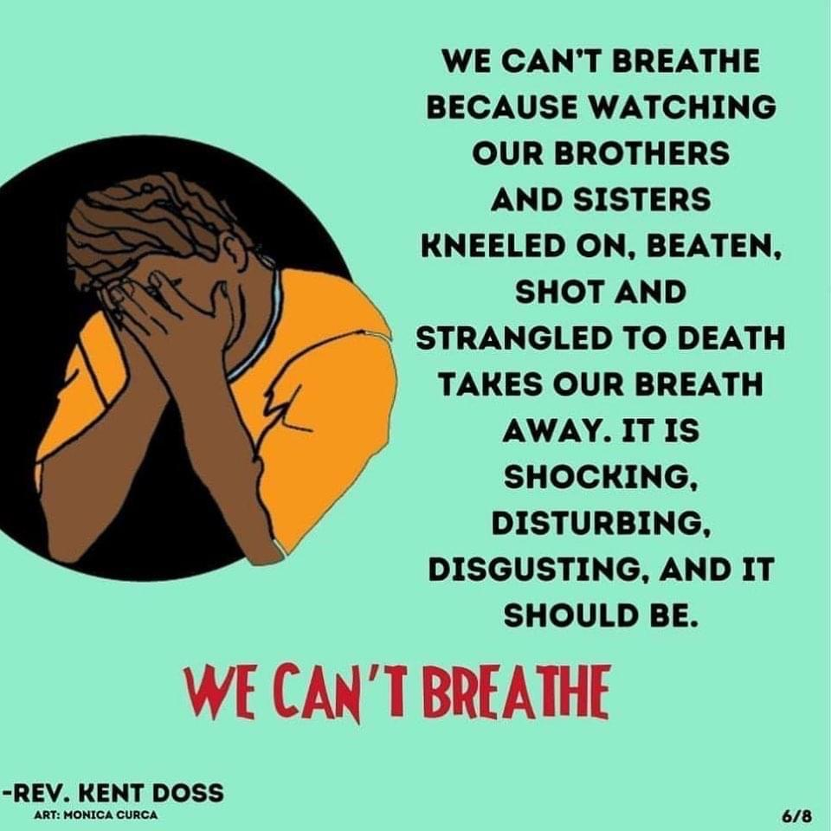

Slide 58
Alonzo Smith

Slide 59
Tyree Crawford

Slide 60
India Kager

Slide 61
La’Vante Biggs

Slide 62
Michael Lee Marshall

Slide 63
Jamar Clark

Slide 64
Richard Perkins

Slide 65
Nathaniel Harris Pickett

Slide 66
Benni Lee Tignor

Slide 67
Miguel Espinal

Slide 68
Michael Noel

Slide 69
Kevin Matthews

Slide 70
Bettie Jones

Slide 71
Quintonio Legrier

Slide 72
Keith Childress Jr.

Slide 73
Janet Wilson

Slide 74
Randy Nelson

Slide 75
Antronie Scott

Slide 76
Wendell Celestine

Slide 77
David Joseph

Slide 78
Calin Roquemore

Slide 79
Dyzhawn Perkins

Slide 80
Christopher Davis

Slide 81
Marco Loud

Slide 82
Peter Gaines

Slide 83
Torrey Robinson

Slide 84
Darius Robinson

Slide 85
Kevin Hicks

Slide 86
Mary Truxillo

Slide 87
Demarcus Semer

Slide 88
Willie Tillman

Slide 89
Terrill Thomas

Slide 90
Sylville Smith

Slide 91
Alton Sterling

Slide 92
Philando Castile

Slide 93
Terence Crutcher

Slide 94
Paul O’Neal

Slide 95
Alteria Woods

Slide 96
Jordan Edwards

Slide 97
Aaron Bailey

Slide 98
Ronell Foster

Slide 99
Stephon Clark

Slide 100
Antwon Rose II

Slide 101
Botham Jean

Slide 102
Pamela Turner

Slide 103
Dominique Clayton

Slide 104
Atatiana Jefferson

Slide 105
Christopher Whitfield

Slide 106
Christopher McCorvey

Slide 107
Eric Reason

Slide 108
Michael Lorenzo Dean

Slide 109
Breonna Taylor

Slide 110
George Floyd

Slide 111
Their Lives Mattered

Slide 112
Black Lives Matter

Slide 113
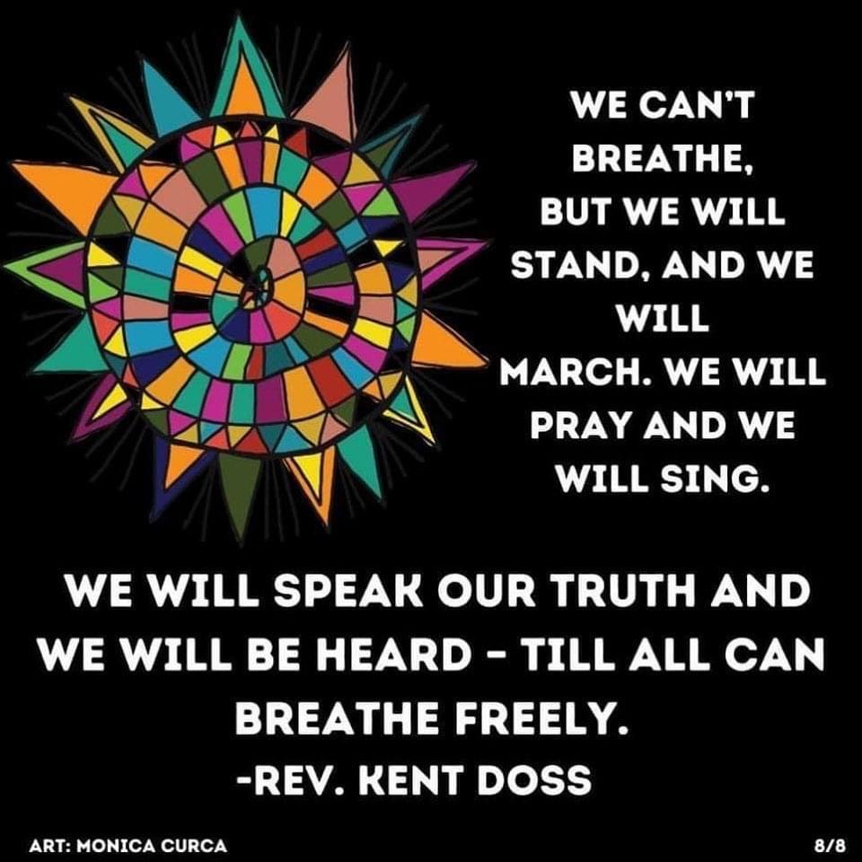

Slide 114
Lamentation—
Raising Our Voices

Slide 115
Learning—
Seeking Spiritual Revelation

Slide 116
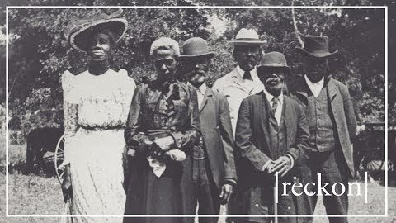
Notes:
What is Juneteenth?

Slide 117
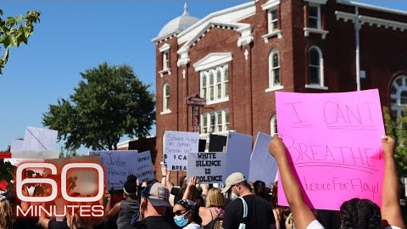
Notes:
How Tulsa's Greenwood Massacre Echoes Today.

Slide 118
Leading—
Creating Space for God’s Purpose to be Manifest

Slide 119

21-Day Challenge

Slide 120
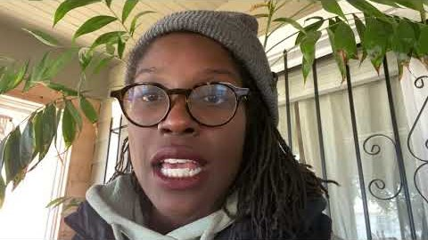
The White Love Project

Slide 121
Support and Engage with Black Owned Business and Anti-Racism Organizations
Now more than ever is the time to donate, support and educate. There are several Bay Area focused organizations that we hope will guide you along the way.
For these resources and to continue the work of Dismantling Structural Racism visit:
www.presbyteryofsf.org/anti-racism-and-justice/

