Slide 1
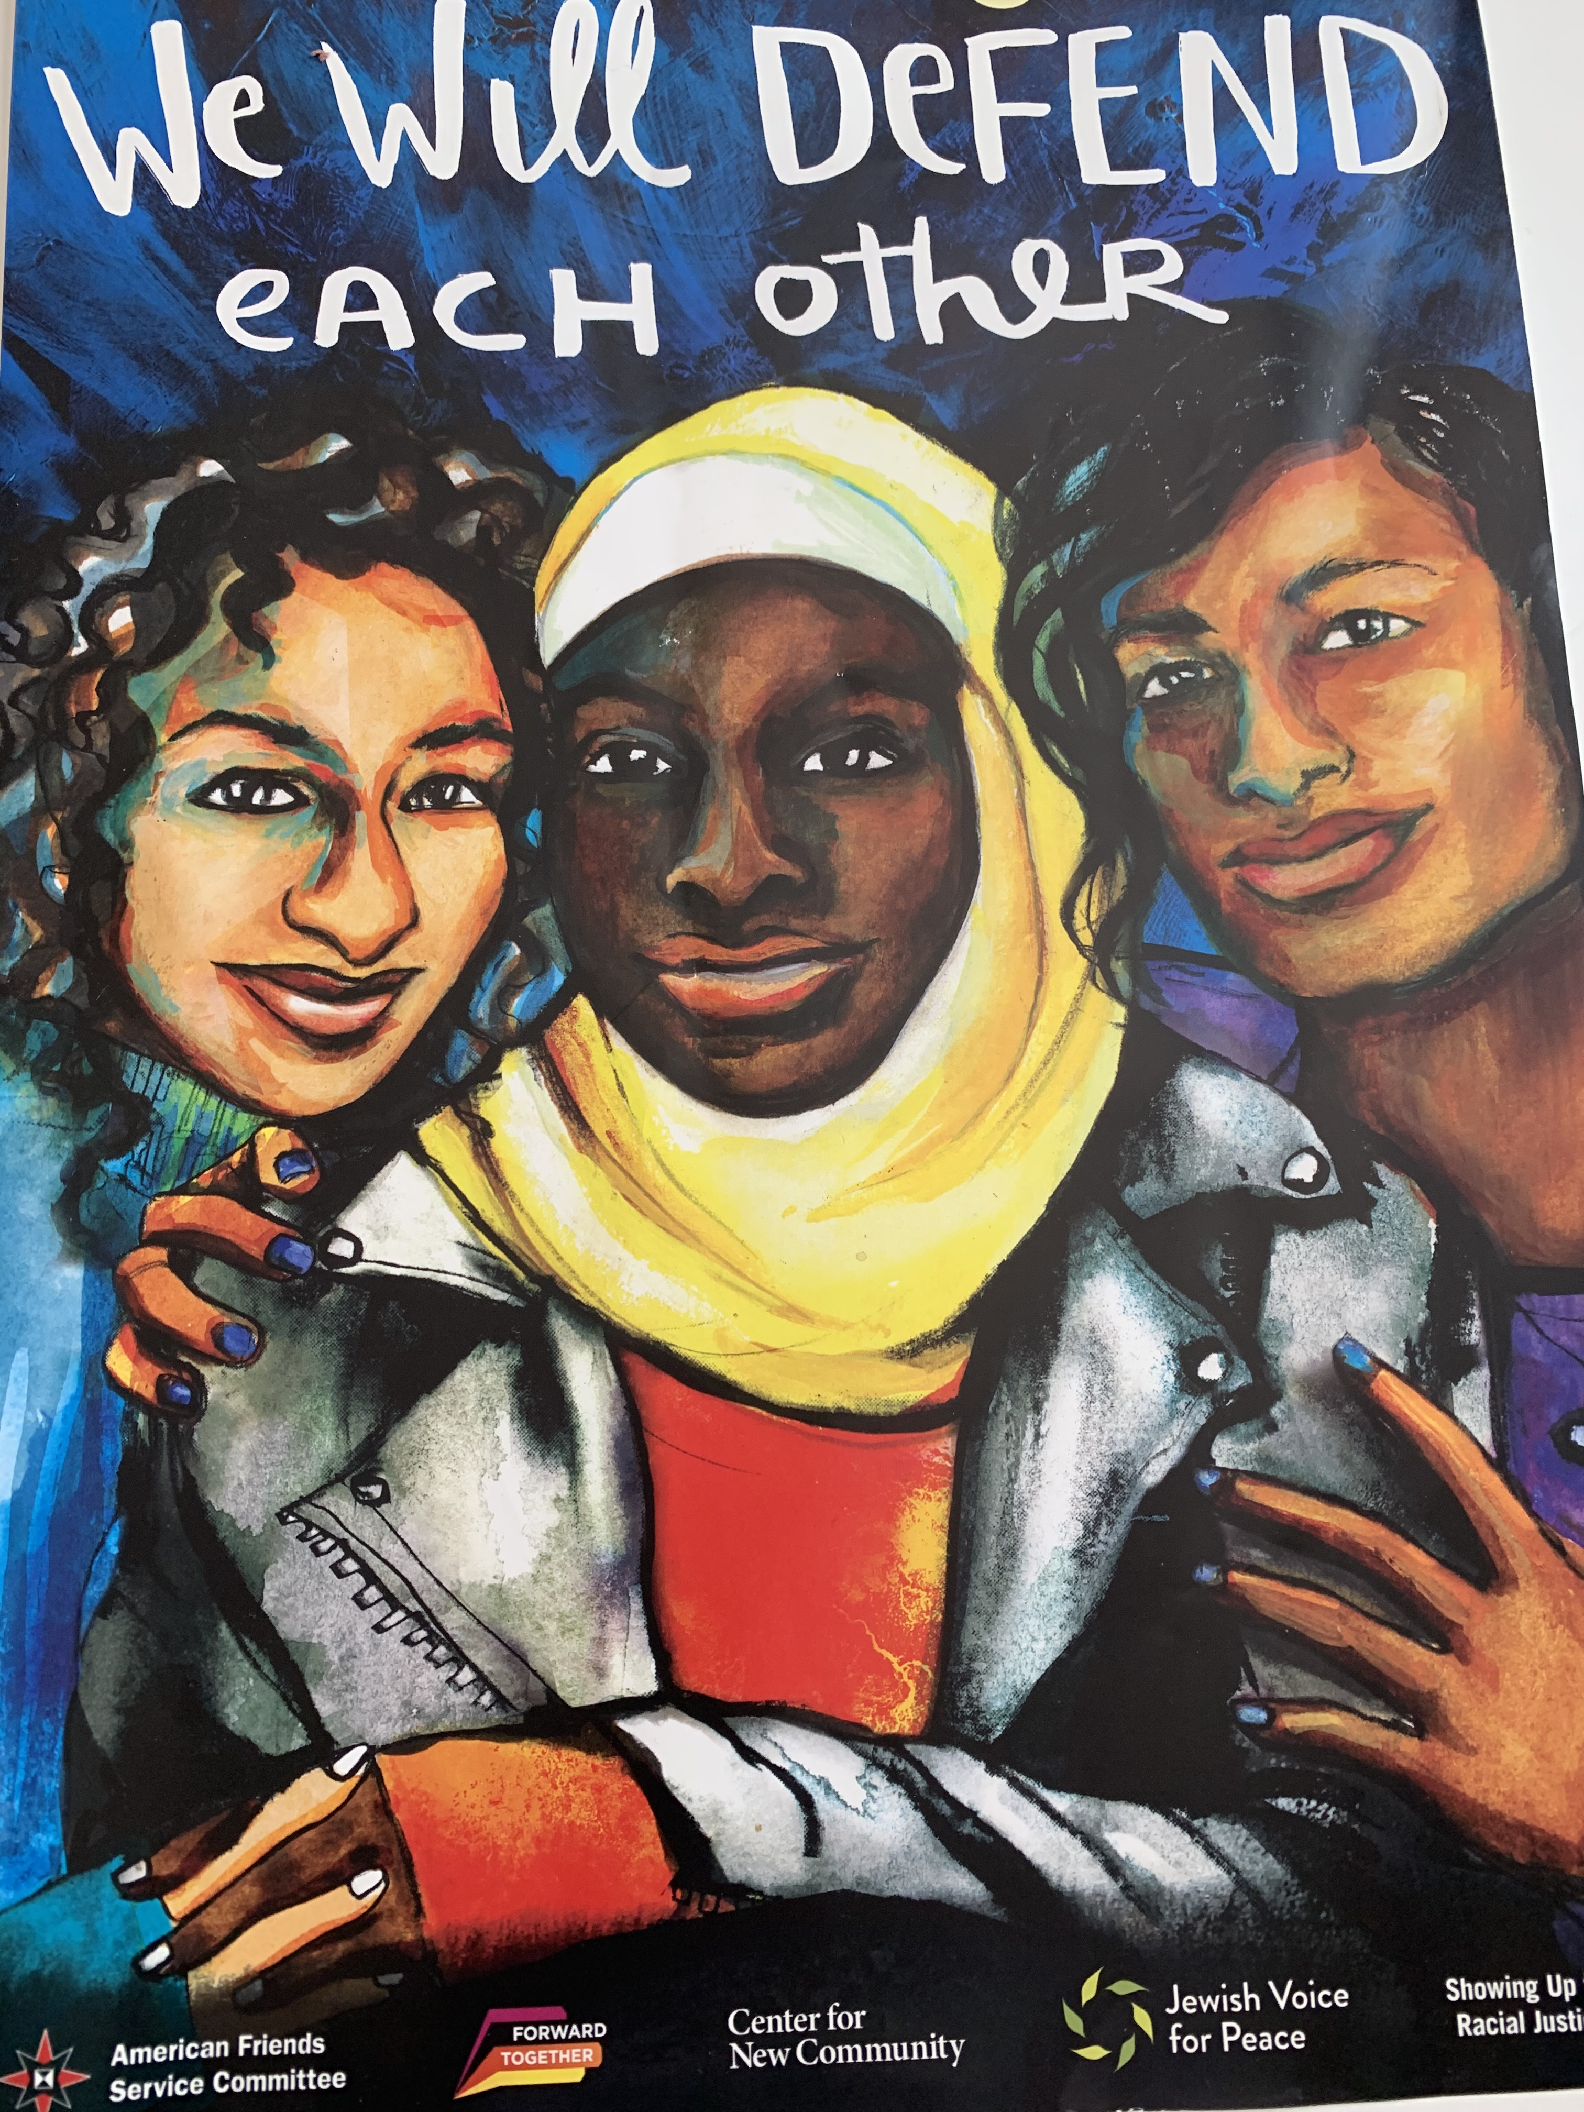
Team 6 Campaign
Notes:
Introduction to Group Presentation
We found some difficulty in attempting to formulate a presentation that would address our individual congregations. We each represent congregations that are unique in size and the degree to which anti-racism has been previously addressed and none of us is aware of any specific harmful narrative that has strongly influenced and shaped it.
Further, each of us is at a different level of understanding and degree of activism ourselves. Most of us have been, and continue to be engaged to varying degrees in the ideas listed in our guide (pages 94-95) as things we can do to individually to disrupt harmful narratives within ourselves. Each of us must determine individually what we will commit to beyond ourselves based on the various gifts and limitations that we have.
For that reason, we chose a hypothetical congregation that has not addressed the issue of systemic racism in our society. Our goal is to express our interest in the church beginning this conversation and educating itself, as a part of our commitment to be followers of Jesus, and to offer suggestions as to how to begin the conversation.

Slide 2
Target Audience
Church Leadership and Activists

Slide 3
Goals
Create awareness of the churches’ complicity of racism
Collect resources of examples of complicity
Show implicit and inherent biases
Provide accessible resources

Slide 4
Initial Strategy
Equip and empower Church Leadership and Activists by opening dialogues with information and conversations about complicity and bias using a variety of sources:
Denominational (ex. The Confession of Belhar)
Biblical
(ex. John 4 1-42; Luke 10:25-37; Matthew 9:9-13, Luke 7:36-50; Matthew 21:18-32)
Historical
Doctrine of Discovery
Land Acknowledgement

Slide 5
Potential Strategies for Expanding to Church Wide Awareness
Investigate becoming a Matthew 25 Church
Initiate a church wide Bible Study
Facilitate a church wide book study
that addresses a specific topic such as church complicity in systemic racism
that addresses a general topic such as white privilege
such as a novel that shows racism as it exists in society
Facilitate a church wide general study such as the one we just completed. Invite a trained facilitator to assist.
Investigate ways that we might share an ongoing conversation/relationship with a racially diverse group of people

Slide 6
Potential Strategies
Lead a book study with videos (see resources)
Individual-Level racism = Internalized and Interpersonal
Systemic-Level racism = Institutional and Structural
Frame, narrative, and messages that all influence our thoughts and actions

Slide 7
Sharing Challenges
Berni Schuhmann
Notes:
There are many challenges to address systemic racism in my small, mostly white congregation. Our diversity consists of two blacks, 2 browns and 1 Asian among the other 100+ white members. While I have brought up this topic with the pastor, it is my opinion he is timid to wade into this topic. At this point, we are at the Bystander Effect: Everyone is waiting for someone else to act. Session had a very light and non informative report on Matthew 25 from the Elder to the Session. No one quite got the jest of what was being said. Session thinks that an informational group would be good. No further details came out of this except that the Elder for Nurture feels he cannot do this because he is a white male and that may not be a good idea.
So, do the black and/or brown members lead this?
Two weeks ago, during a Zoom Sunday service, the pastor posed the question to the group: What is your first recollection of race. It became very evident very quickly that THIS was not the best way to begin a discussion. The overwhelming response became the "Color Blind Response". The word "colored" was used. Words of those people and them were common. There was just so much of all the WRONG approaches used to address racism all wrapped into one Zoom service discussion.
So now we are back to step #1: What do we do now and who does it.?
My feeling is that group discussions should be a first step to a book study.

Slide 8
Resources
Videos
Dr. Erica Gault – a scholar of Black religion and culture – is an Assistant Professor of Africana Studies at the College of Humanities. John 20:24-28
https://fb.watch/65-HtBmg5G/
Move the Race Conversation Forward
https://www.youtube.com/watch?v=LjGQaz1u3V4
How to overcome
https://www.ted.com/talks/verna_myers_how_to_overcome_our_biases_walk_boldly_toward_them#t-5275
Books
The Color of Compromise by Jemar Tisby
The Good White Racist by Kerry Connelly (confronting your role in injustice)

Slide 9
Team 6
Barbara Ahlquist, Lafayette Orinda Presbyterian
Berni Schuhmann, St. Andrew Presbyterian Pacifica
Leigh Ann Bandet, Christ Church, Berkeley
Evangeline Pua, GKI (Indonesian Presbyterian Church)
Pamela Mirabella, First Presbyterian Church of Berkeley
Arlene Gordon, the member of the Presbytery, an Honorably Retired Minister of Word and Sacrament

