Slide 1
What Lies Between Us?
Group 2 Project Results

Slide 2
Goal and Message
Our audience – Individual church congregations
Goal – To equip ourselves and our loved ones with the tools we need to make a difference and not cause harm and to educate our congregants how some of our coded language can affect others.
Message
Jesus said to “Love thy neighbor as thyself”. Who is my neighbor? Why would anyone want to be my neighbor?
How coded language (CL) can impede my relationship with my neighbor.
CL is substituting terms describing racial identity with seemingly race-neutral terms that disguise explicit and/or implicit racial animus.
It injects language that triggers racial stereotypes and other negative associations without the stigma of explicit racism.
Some examples on the next two slides

Slide 3

“Law and Order”
“That is a “sketchy” neighborhood, isn’t it?”
“Ghetto”
“All lives matter”
“I grew up sheltered.”
“You’re so articulate! ”
“There is only one human race”
“You don’t have an accent!”
“Urban”
“Is your hair real?”
“We need qualified people.”
“Where are you really from? ”
“Underprivileged”

Slide 4
RACISM
“Law and Order”
“That is a “sketchy” neighborhood, isn’t it?”
“Ghetto”
“All lives matter”
“I grew up sheltered.”
“You’re so articulate! ”
“There is only one human race”
“You don’t have an accent!”
“Urban”
“Is your hair real?”
“We need qualified people.”
“Where are you really from? ”
“Underprivileged”

Slide 5
Strategy
As we build our capacity to engage in courageous conversations and living in the chasm of racial division, WE WILL BE CREATORS of safe spaces where people can be transparent and vulnerable. Inspired and sustained by love, such spaces cultivate healing and change that overflow in the lives of those around us. And that’s what we are going for. Because when race/ism is addressed in the context of love, it loses its power!
Dr. Lucretia Berry
What Lies Between Us?
Page 37

Slide 6
Strategy
Specifically, we could use media clips, personal reflections, small group discussions, etc.
E.g., materials from Brownicity, from our “What Lies Between Us” study, etc.
The end of our prayers ought to be deciding with great courage to do something. We can be the people God uses to be the answer to our prayers.
Rev. Dr. James C. Howell
Sr. Pastor Myers Park United Methodist Church, Charlotte, NC
Adjunct Professor, Duke Divinity School

Slide 7
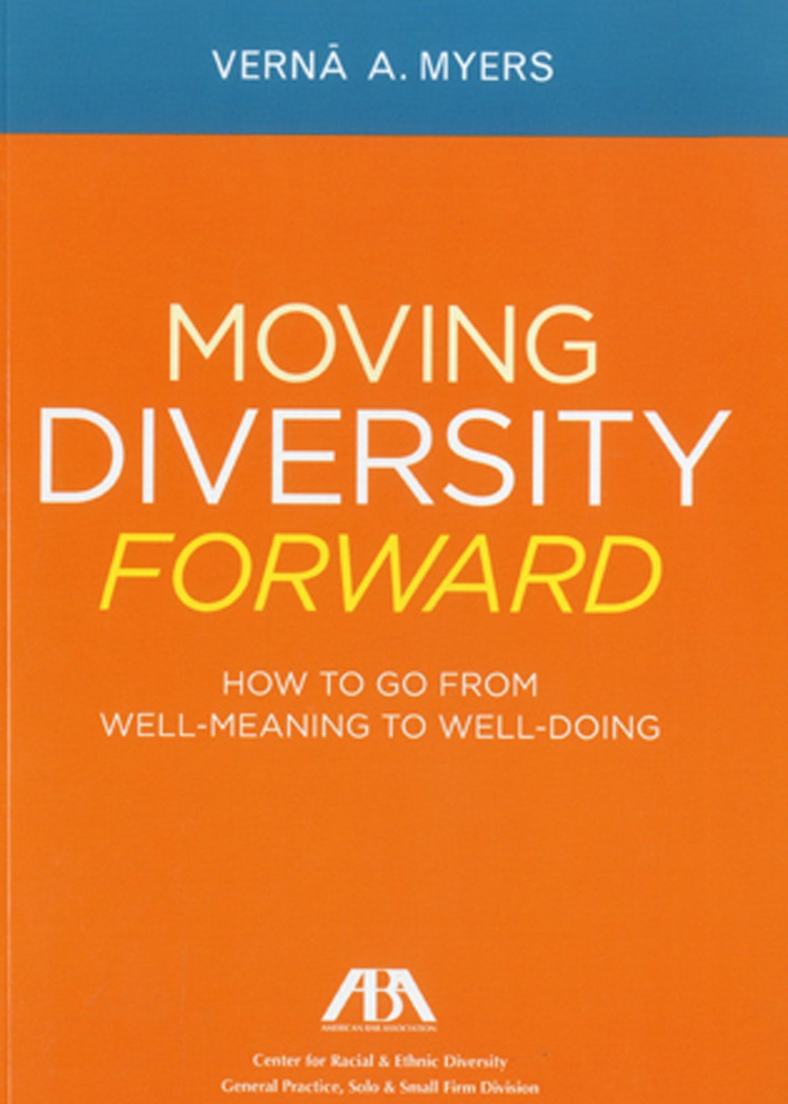
Strategy
Encourage “action”
Encourage use of simple/straight forward “action” steps
Resource: “Moving Diversity Forward” by Verna Myers
“The S-A-M-E Dance”
S - STOP: Stop expecting and pretending to know
A - APOLOGIZE: Don’t hide behind your “intent”
M - MISTAKES: It’s okay to make mistakes
E - ENGAGE: Start the dance of engagement

Slide 8
Supporting Verses
Don’t copy the behavior and customs of this world, but let God transform you into a new person by changing the way you think. Then you will learn to know God’s will for you, which is good and pleasing and perfect. Romans 12:2(Voice)
But whenever someone turns to the Lord, the veil is taken away. For the Lord is the Spirit and wherever the Spirit of the Lord is, there is freedom. So all of us who have had that veil removed can see and reflect the glory of the Lord. And the Lord – who is the Spirit – makes us more and more like Him as we are changed into His glorious image. 2 Corinthians 3:16 (NLT)

