Slide 1
Change the Narrative
Room 7 Project
Elizabeth Clendenin, Eloise Gilland, Gwendolyn Jeong, Jane Kraut, Loriann Mastromarino, Tom Durff

Slide 2
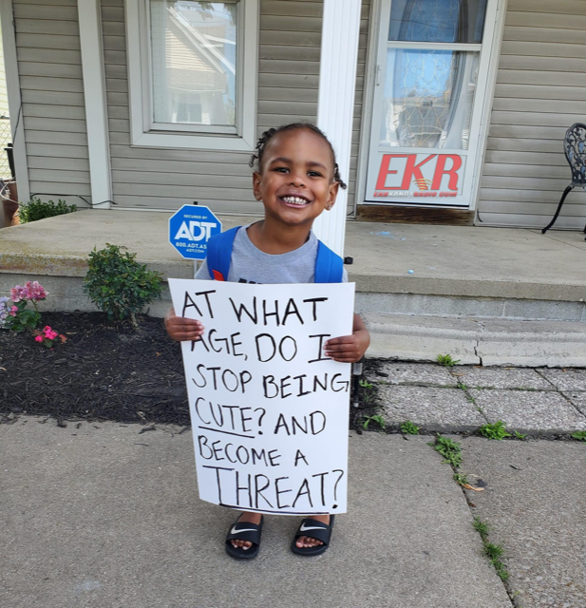

Slide 3
Instead of a threat,
see me as...

Slide 4
an artist.

Slide 5
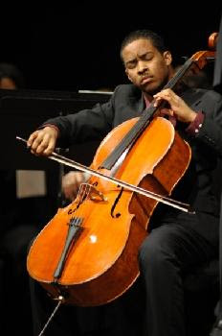

Slide 6
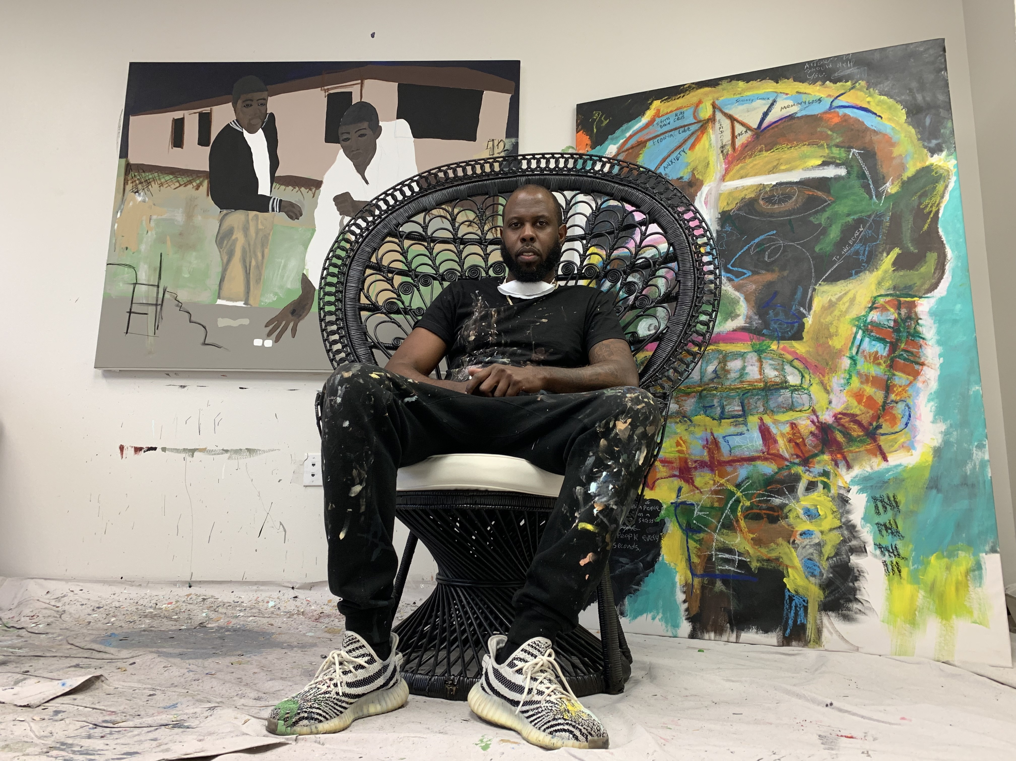

Slide 7
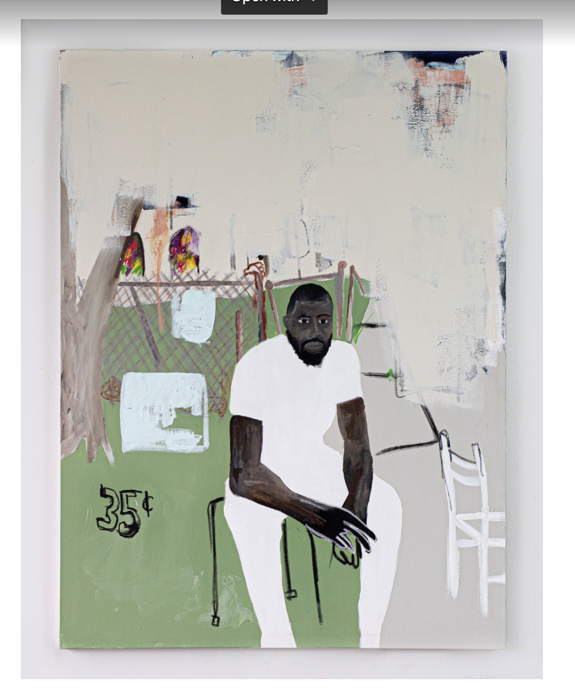

Slide 8
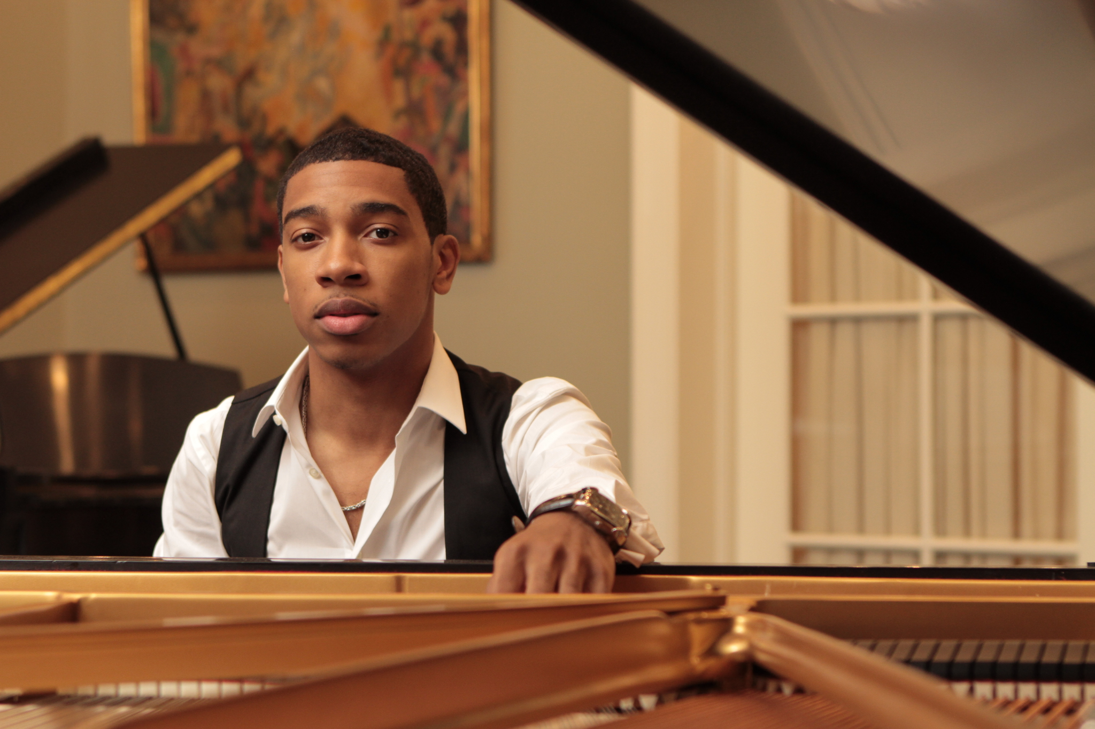

Slide 9
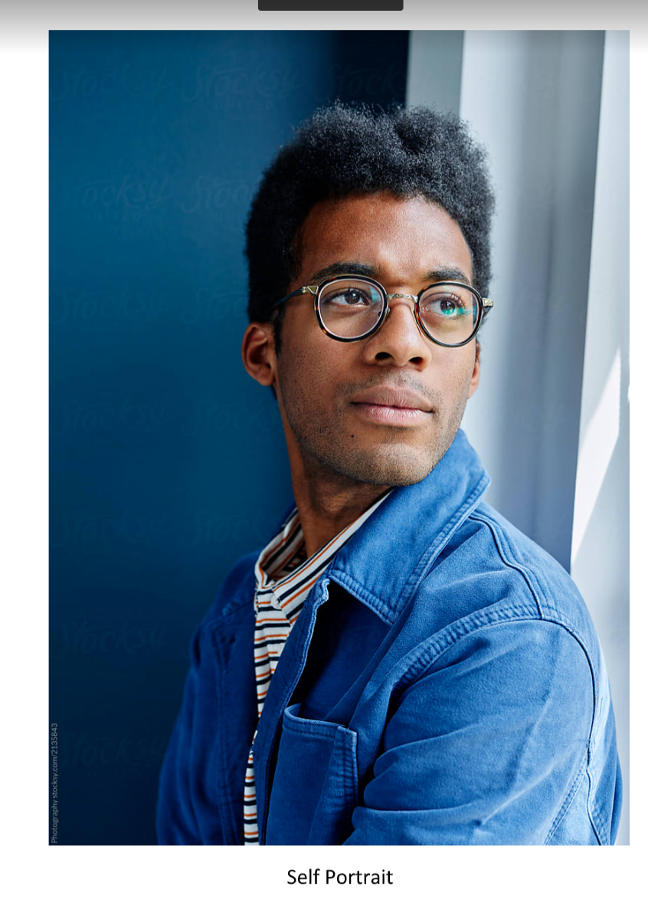

Slide 10
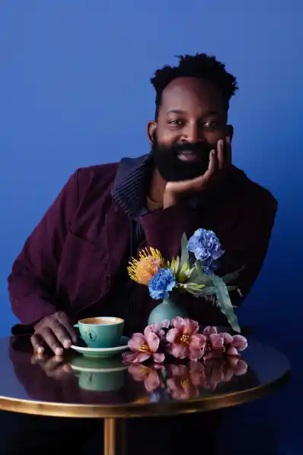

Slide 11
See me as a provider of the food you enjoy.

Slide 12
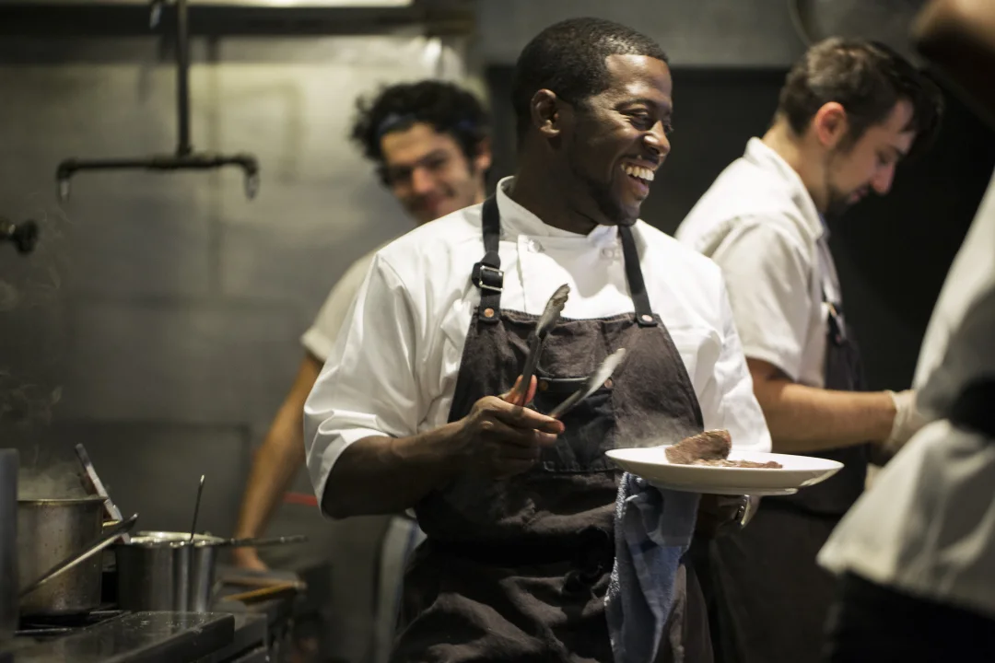

Slide 13
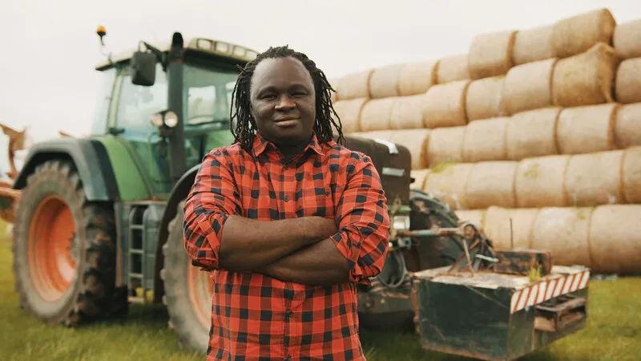

Slide 14


Slide 15
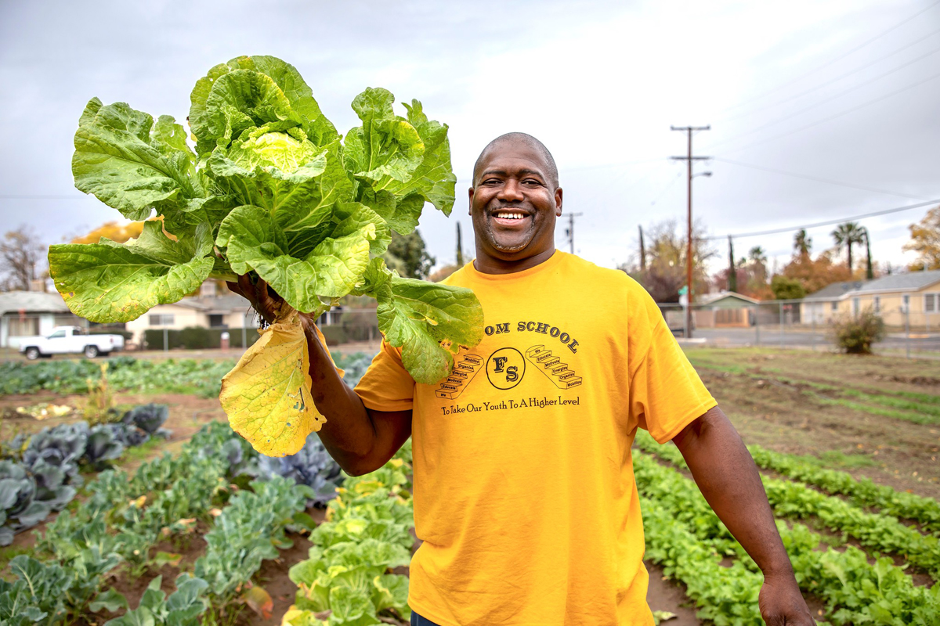

Slide 16
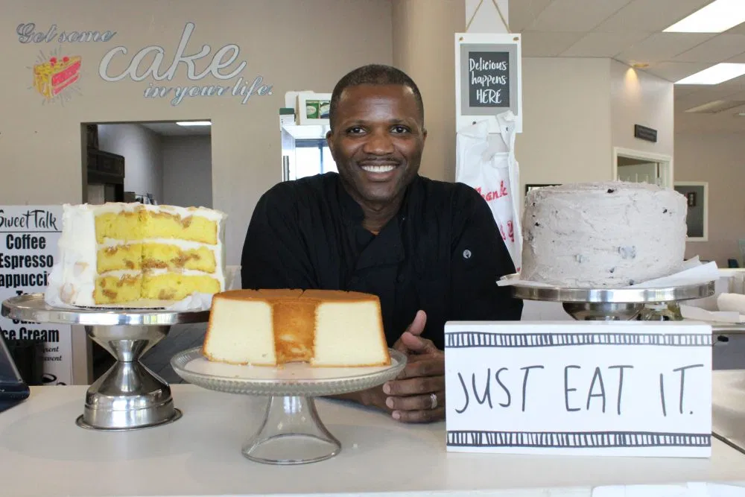

Slide 17


Slide 18
See me as a health care hero.

Slide 19


Slide 20


Slide 21
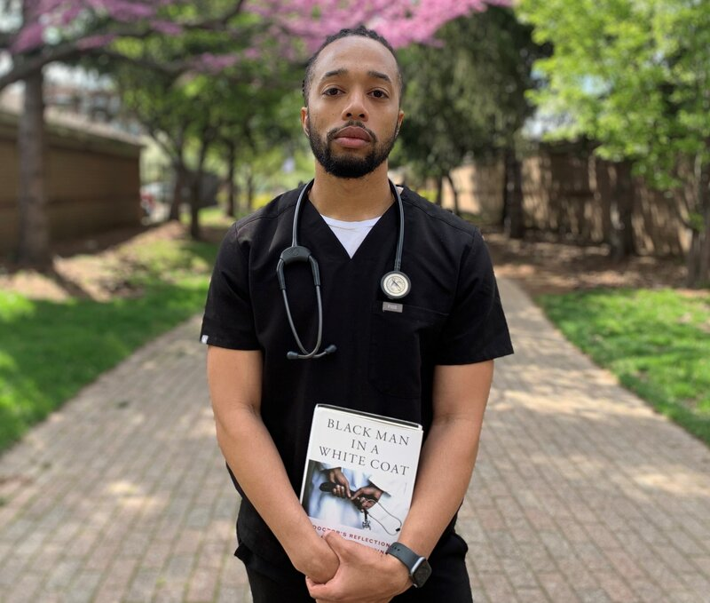

Slide 22


Slide 23
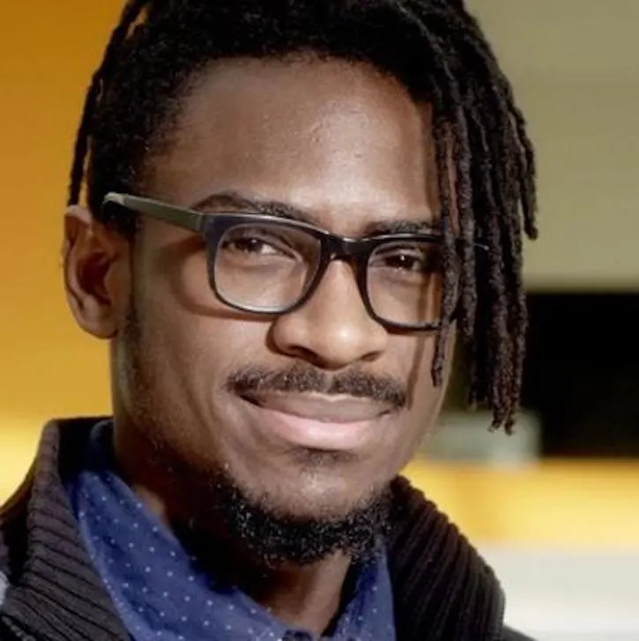

Slide 24


Slide 25
See me as a lawyer.

Slide 26
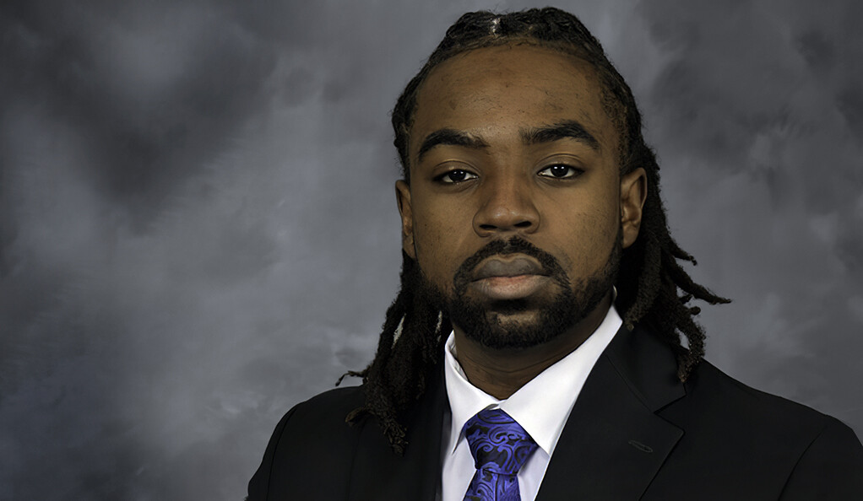

Slide 27
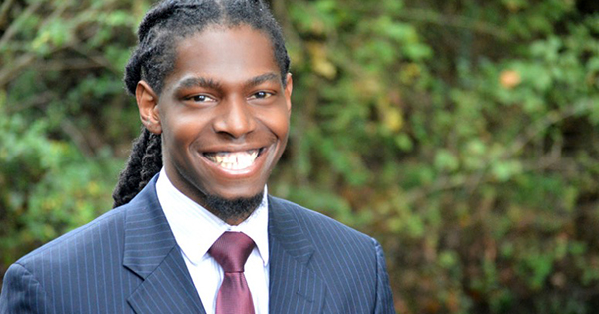

Slide 28


Slide 29
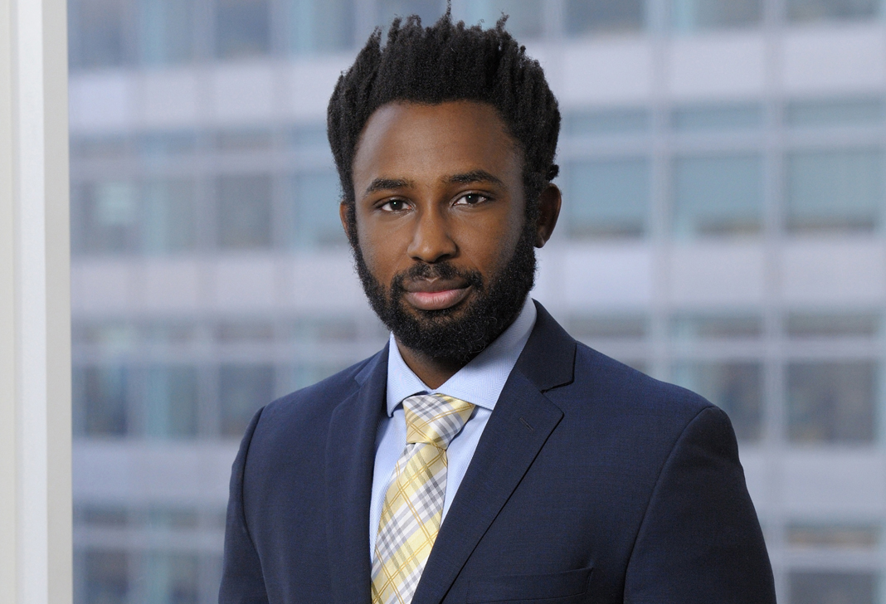

Slide 30


Slide 31
See me as a teacher.

Slide 32
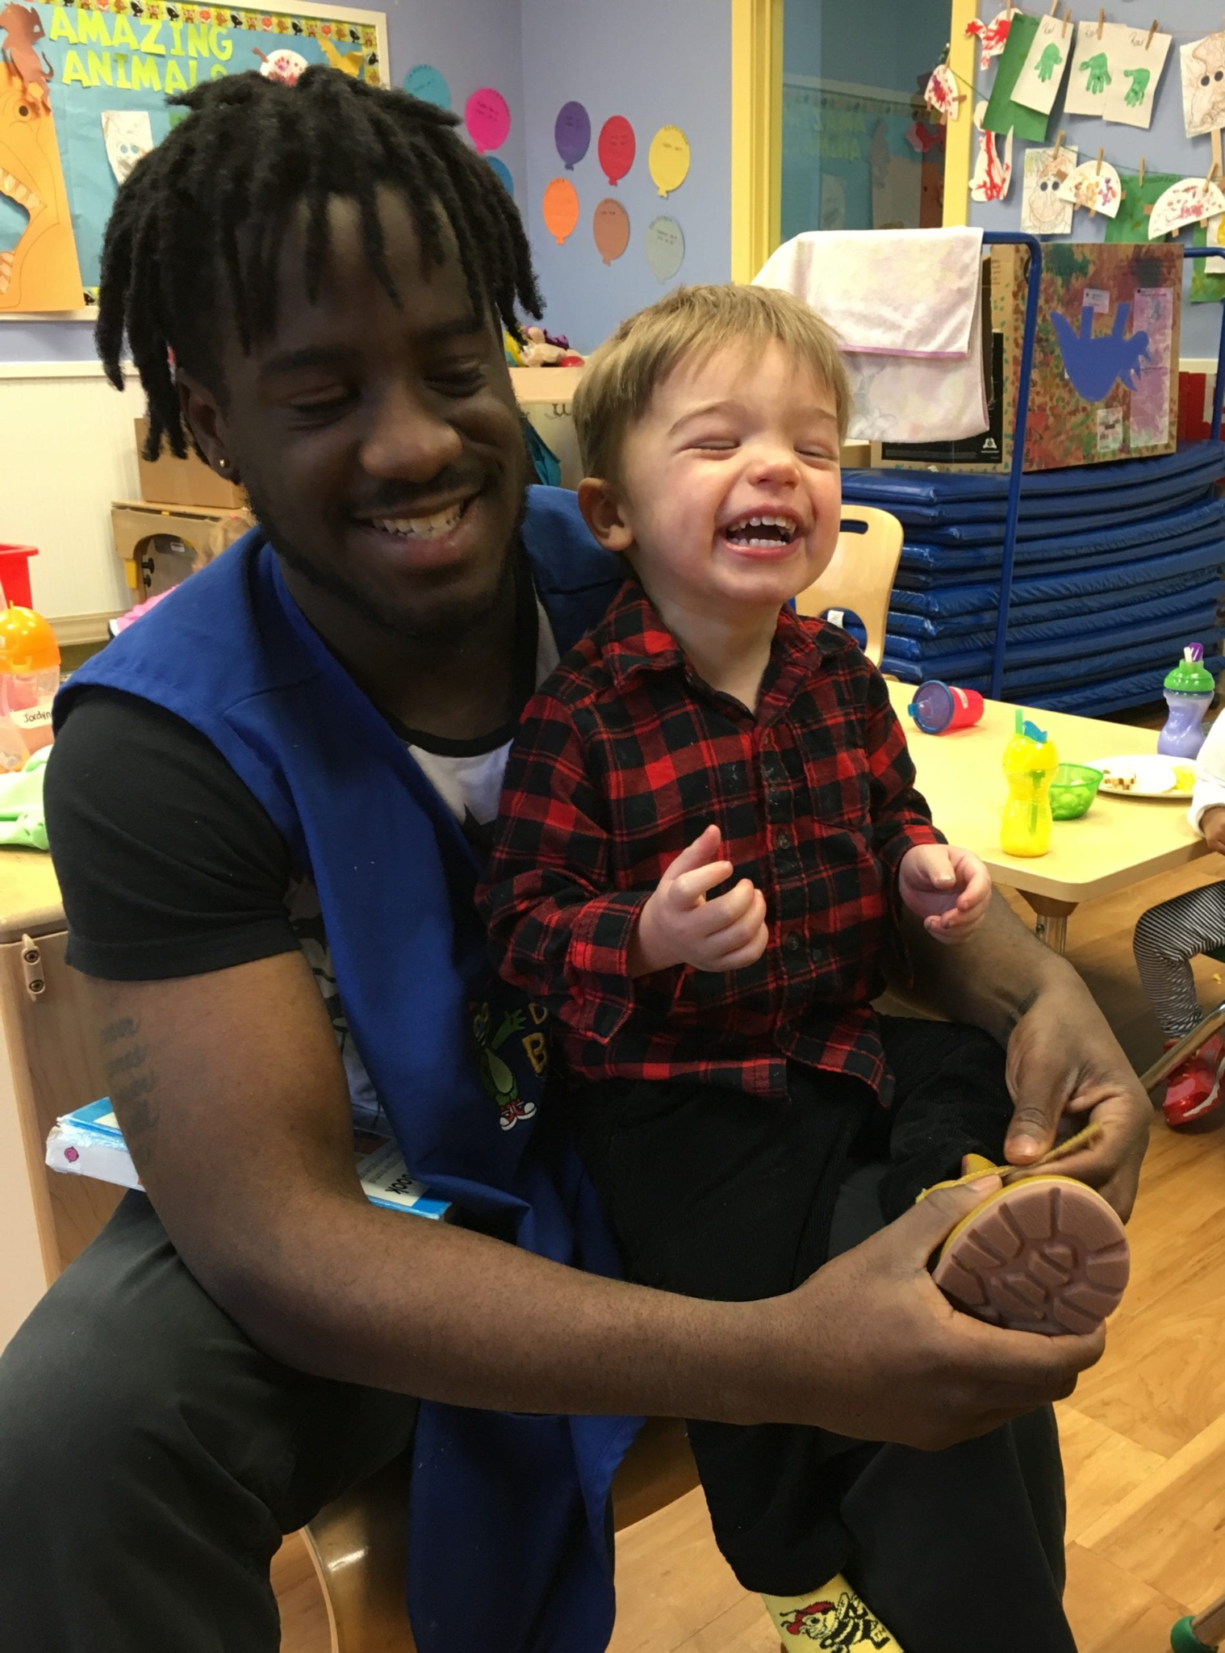

Slide 33


Slide 34
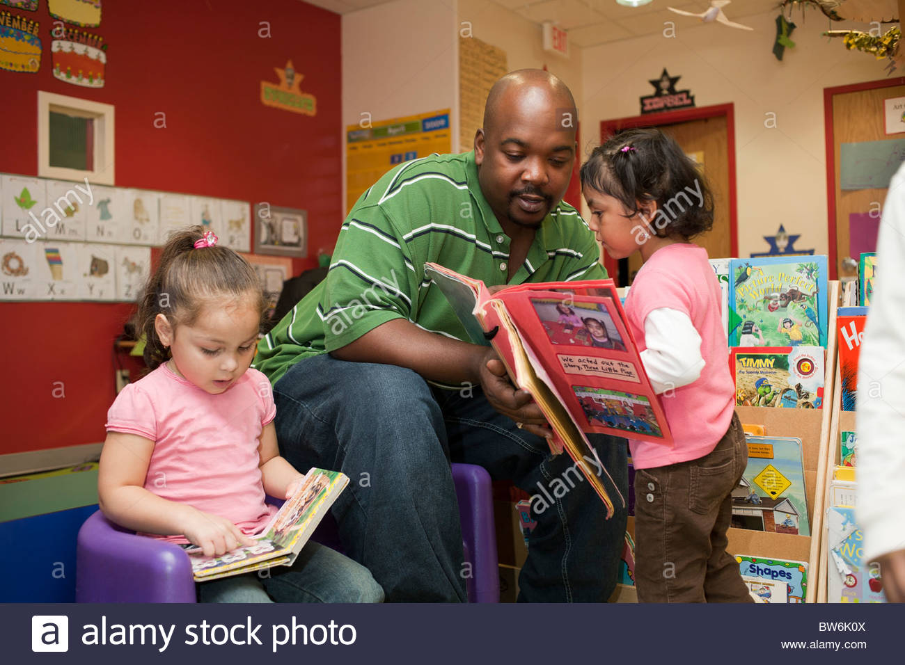

Slide 35
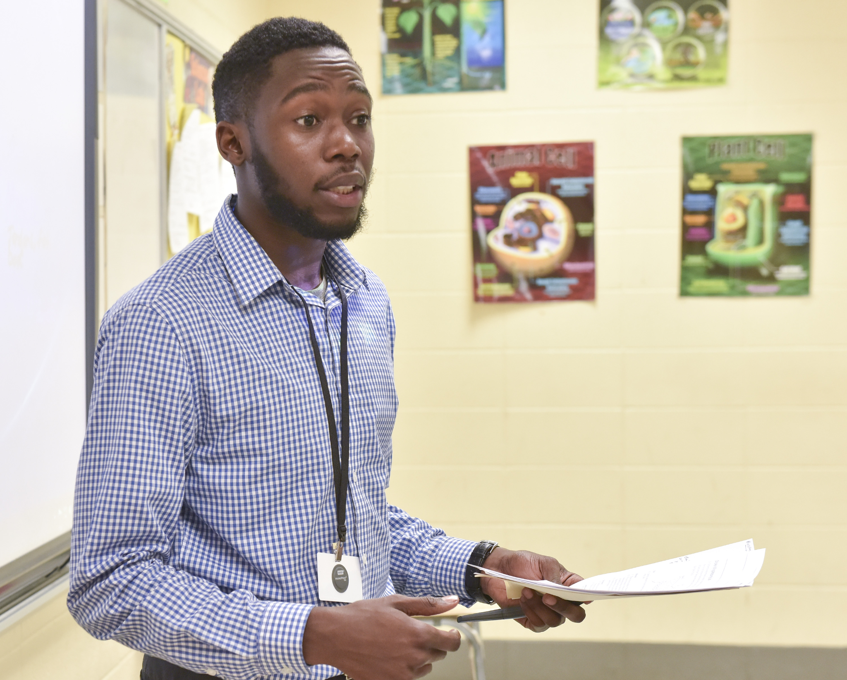

Slide 36


Slide 37
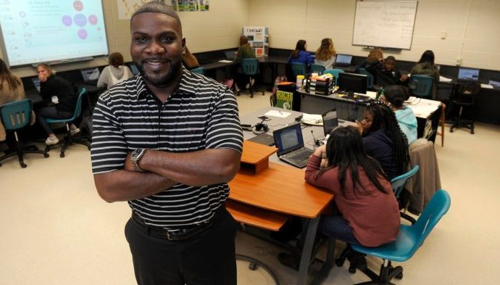

Slide 38
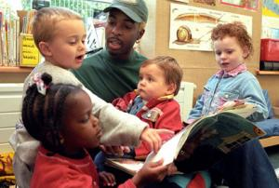

Slide 39
See me as a scientist.

Slide 40
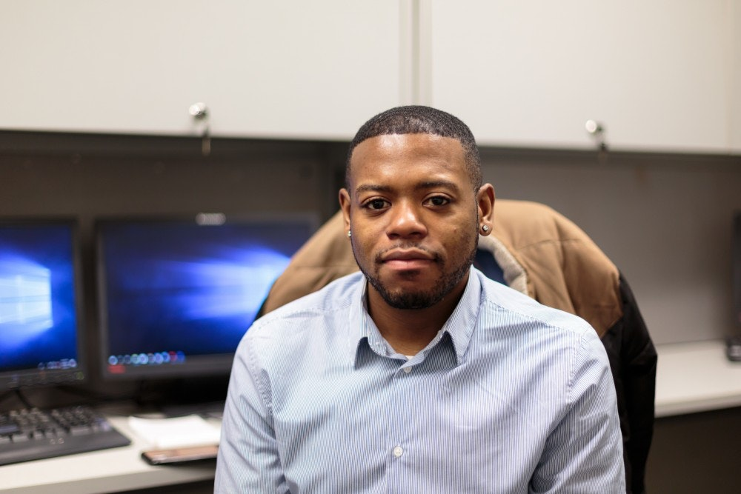

Slide 41


Slide 42
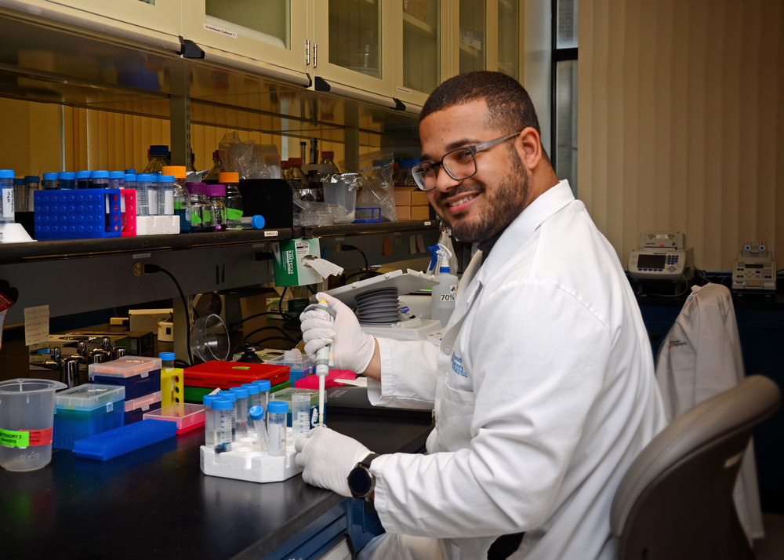

Slide 43
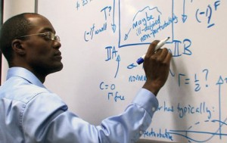

Slide 44
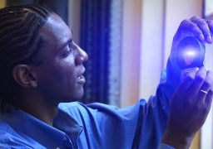

Slide 45
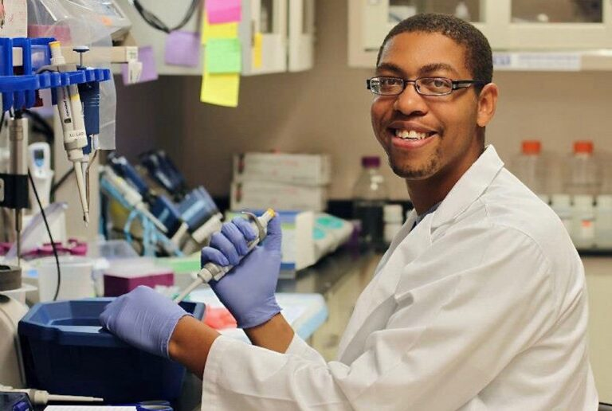

Slide 46
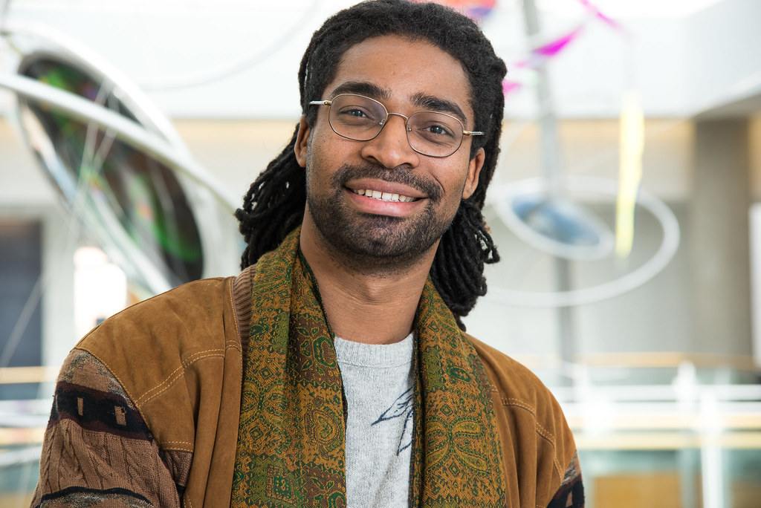
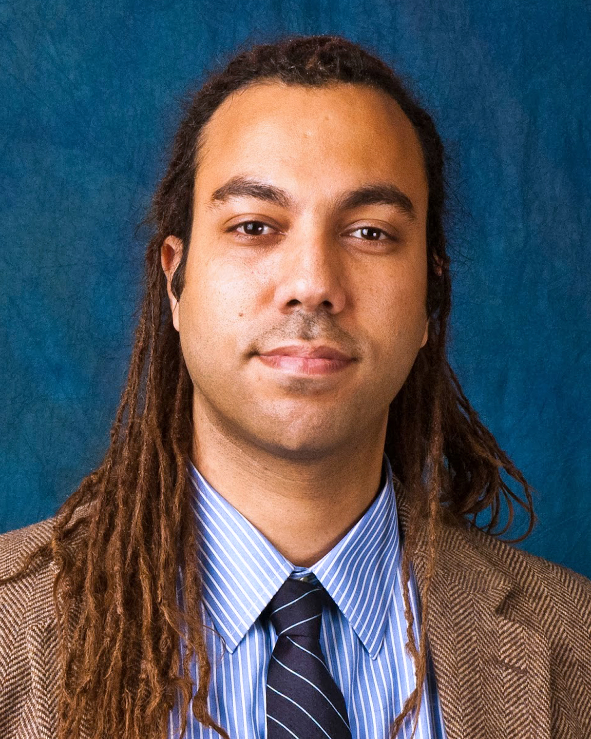

Slide 47
See me as a lover of pets.

Slide 48
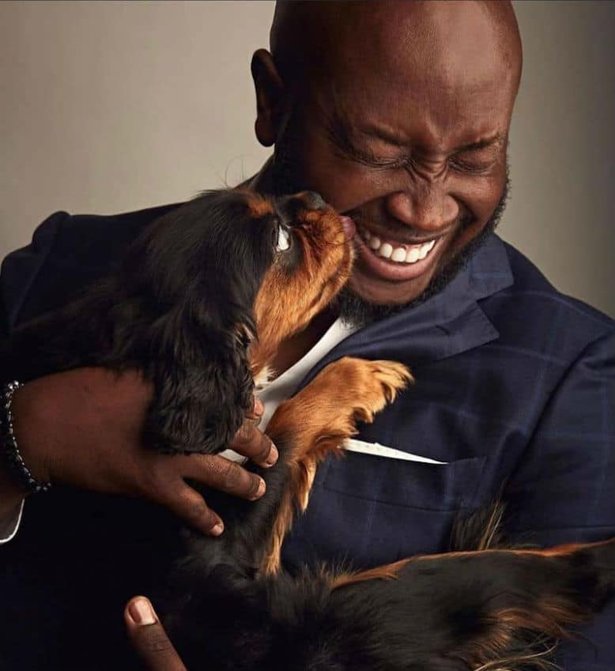

Slide 49


Slide 50
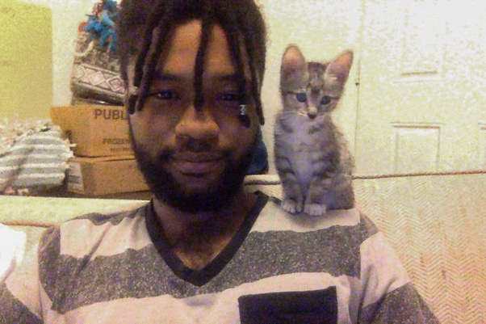

Slide 51
See me as a student.

Slide 52
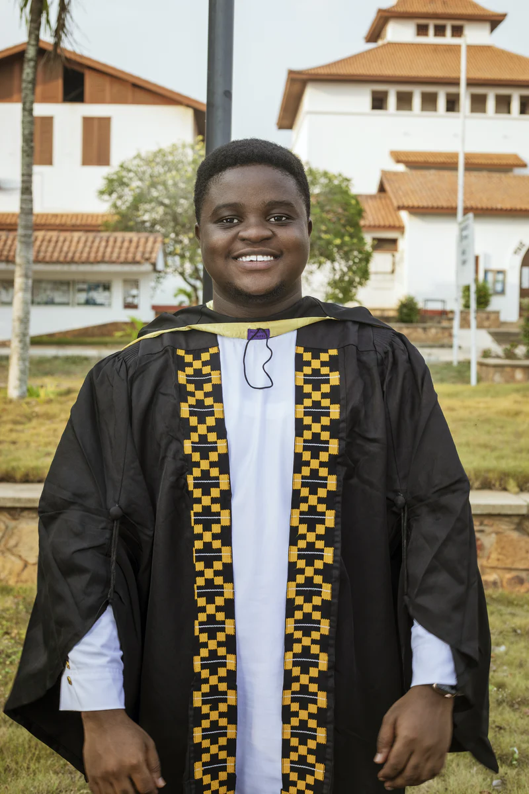

Slide 53


Slide 54
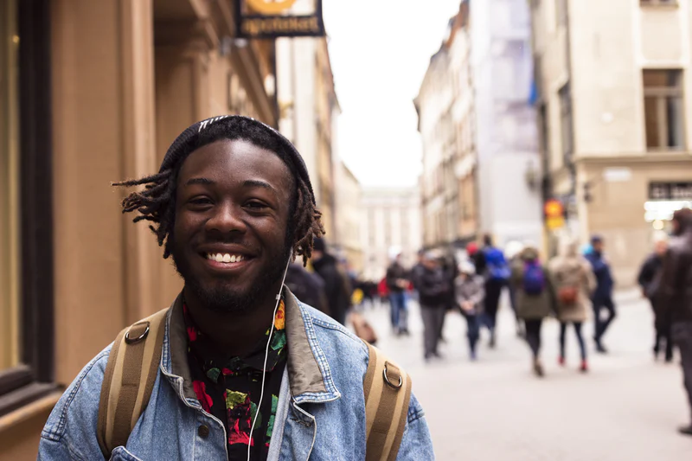

Slide 55


Slide 56


Slide 57
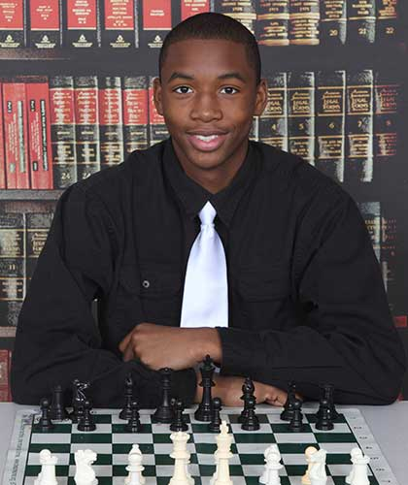

Slide 58
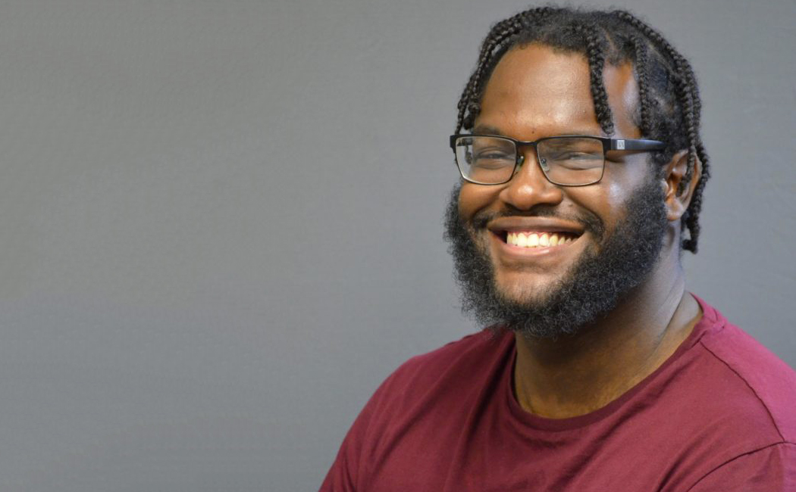

Slide 59
See me as a loving father.

Slide 60


Slide 61


Slide 62
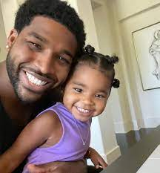

Slide 63
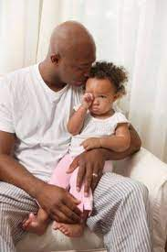

Slide 64


Slide 65
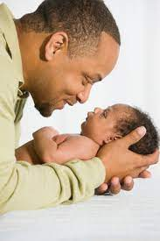

Slide 66
See me as the image of God.

